Slide 1






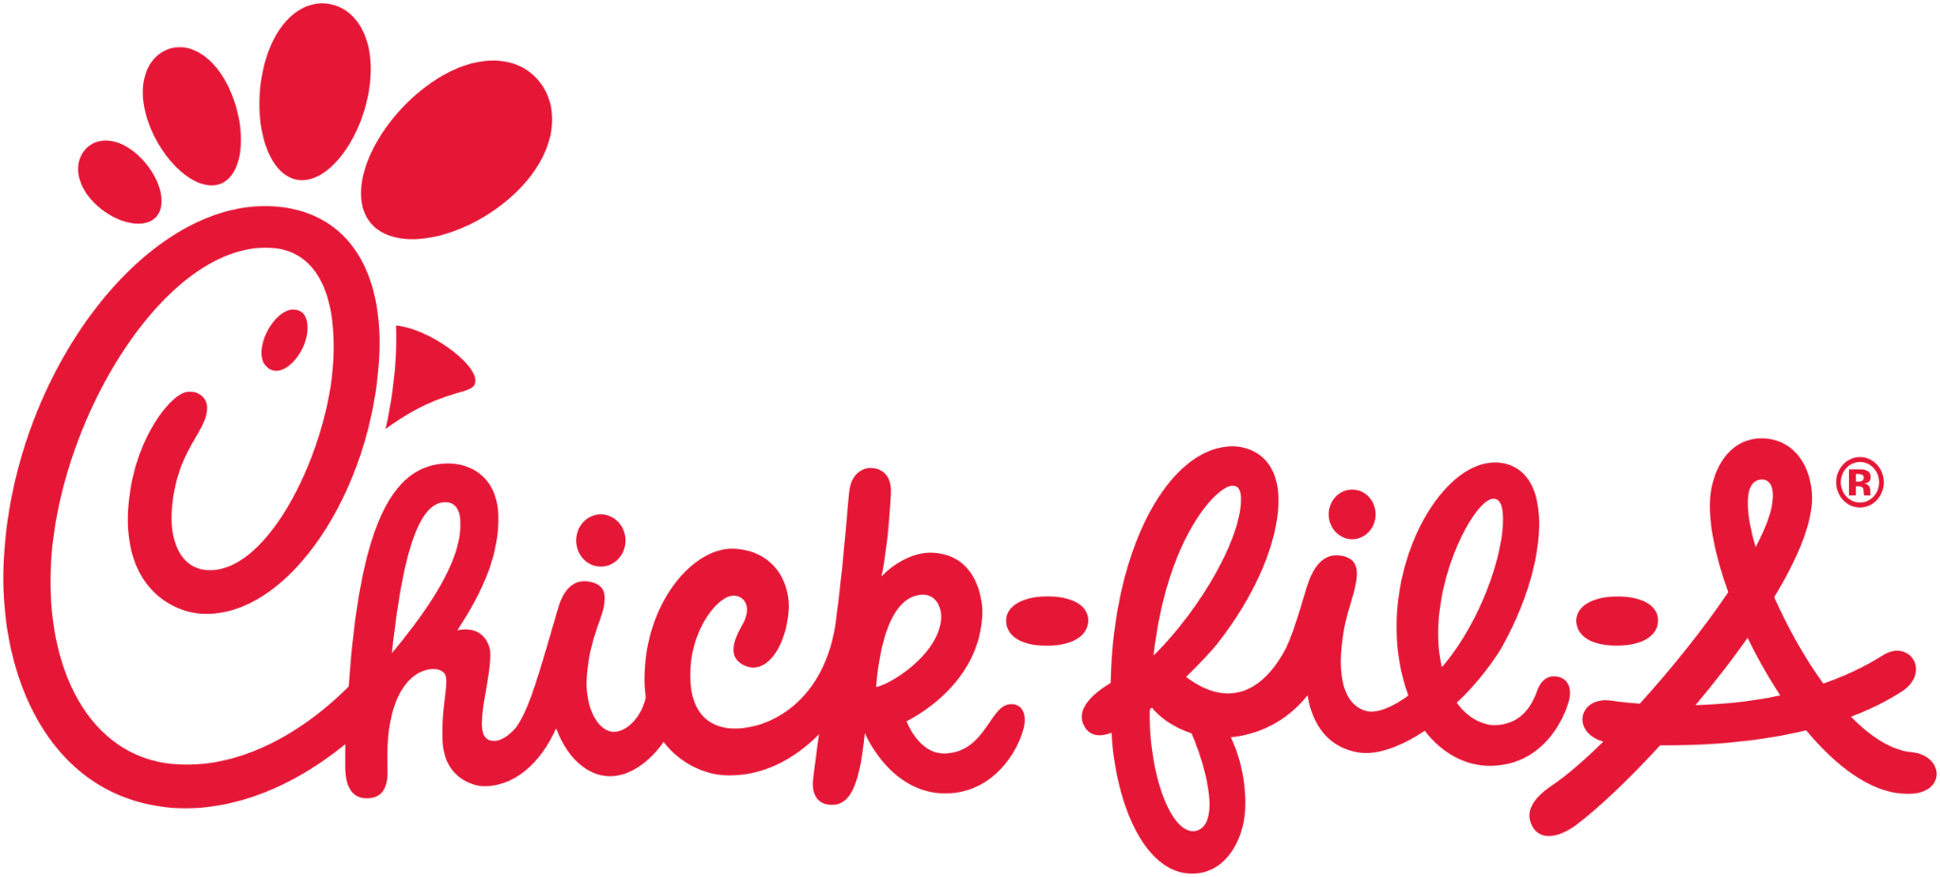
Group 6: Sheng Zhi Luo, David Oceguera, Melisa Tahiraj, Andrew Mejia, Tony Gana

Slide 2
Background Story
Chick-Fil-A’s CEO wants to implement a reputation incentive project for benefits of renewal fee deduction after year of 2025:
The project needs evaluation of the franchisee’s performance based on their geographical influence, rating and competitive advantages.
Before the project becomes reality, we will first test the water by starting with a sample analysis on Los Angeles and Houston to determine its feasibility.
The purpose of the project is to help setting management objectives to improve Chick-Fil-A’s business image.

Slide 3
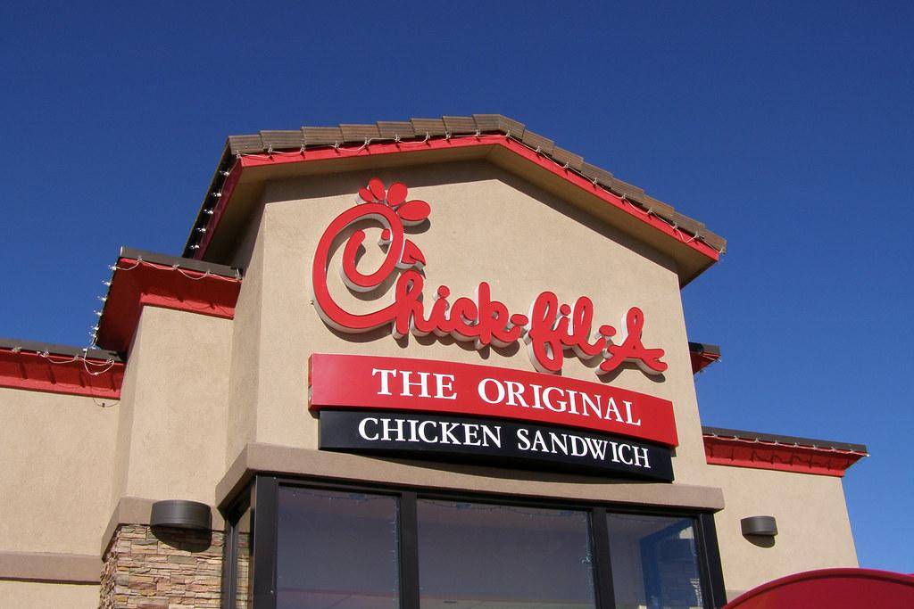
Objective
Oversee the geographical influence on both areas
Determine the restaurant’s overall performance
Recent improvement of customer satisfaction
Competition with other similar businesses in the area

Slide 4
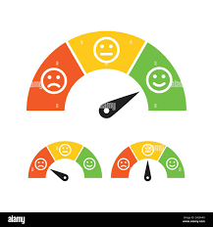


Table of Contents
Geographical Influence
Customer Satisfaction
Competition

Slide 5




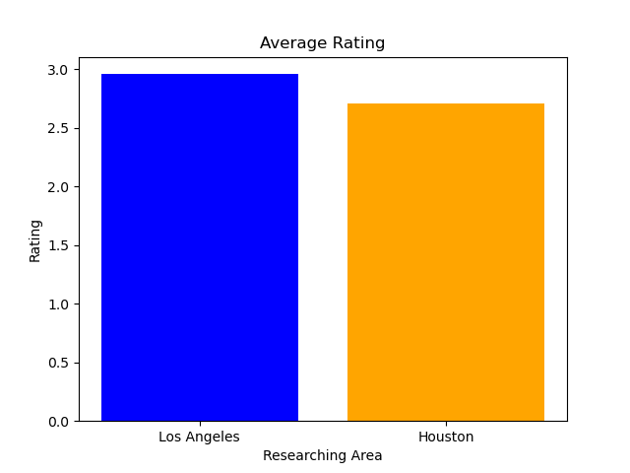
Los Angeles
Houston
Rating of LA is slightly higher than rating of Houston.
Management can set an objective on rating, such as:
LA: 3.5
Houston: 3.4

Slide 6
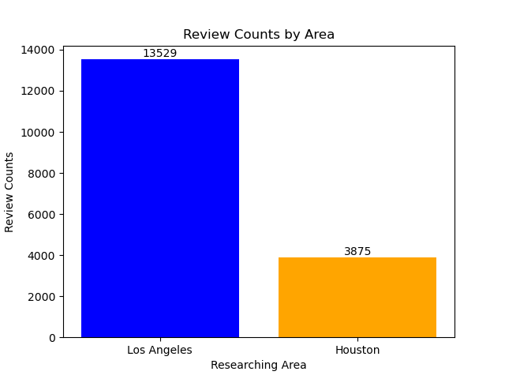
Los Angeles
Houston
Review counts of LA is much higher than review counts of Houston.
Management can set a quote of review counts, such as:
LA: 17,500 (~30% increase)
Houston: 5,000 (~30% increase)
10% deduction on renewal fee if both requirements of rating and review counts are satisfied

Slide 7
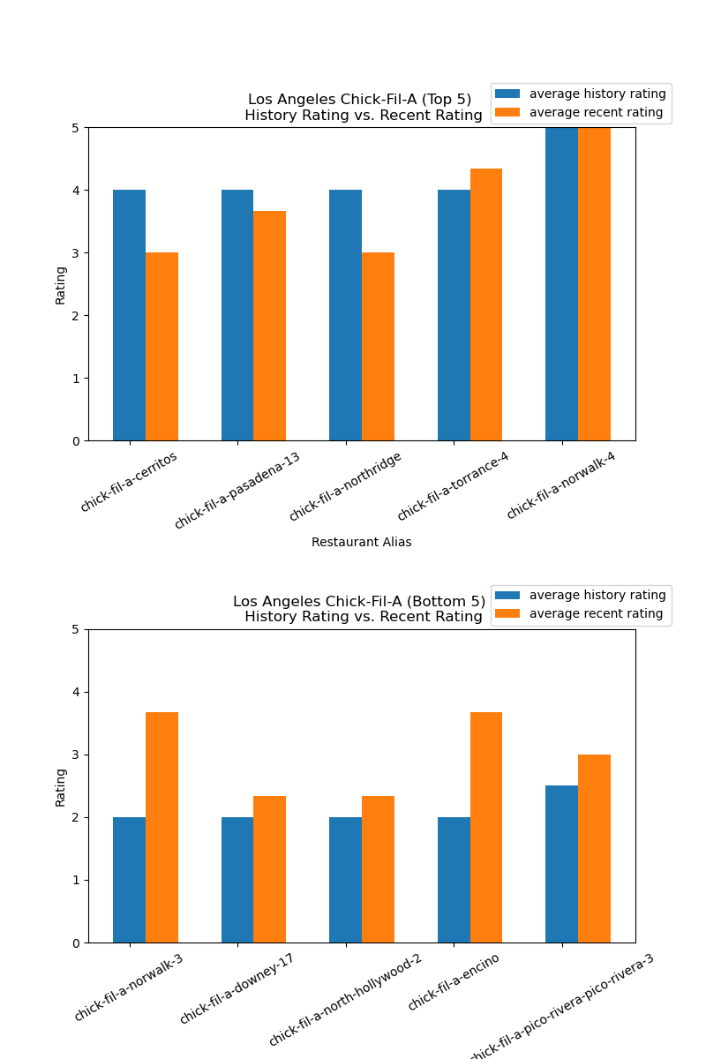
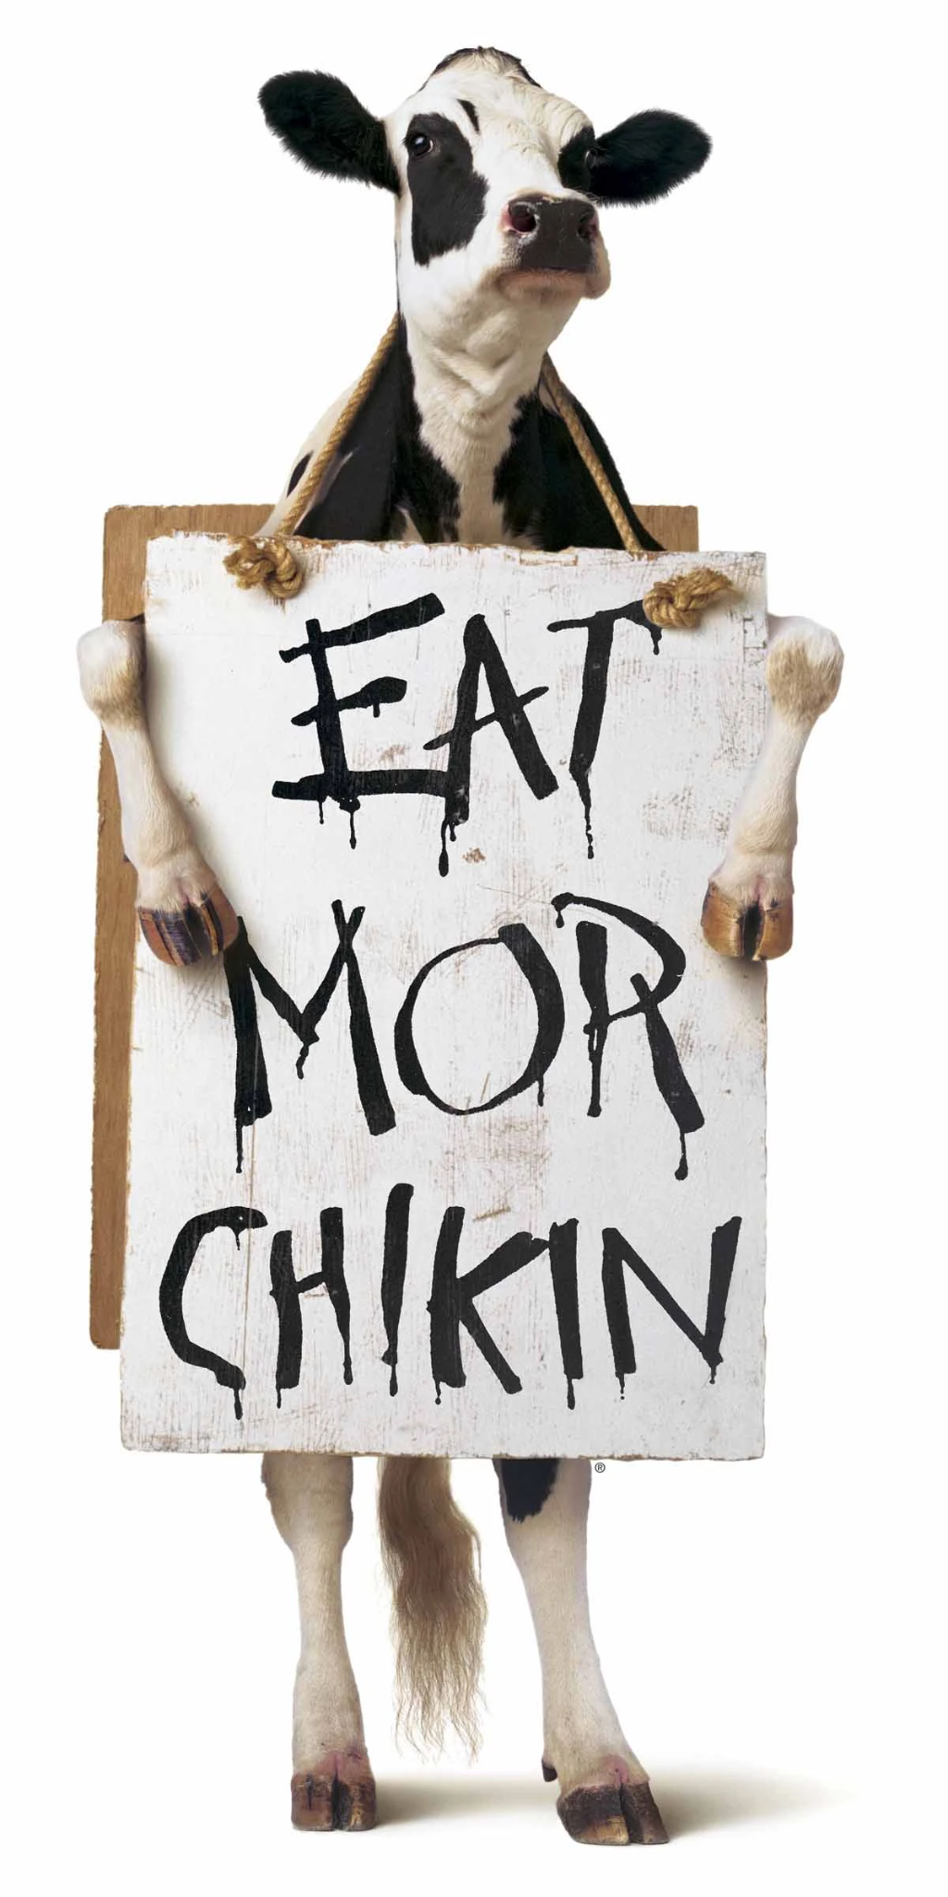
Customer Satisfaction
Los Angeles, CA (Top 5)
1 out of 5 have experienced an increase in rating
3 out of 5 have seen a decrease in rating
Los Angeles, CA (Bottom 5)
5 out of 5 have experienced an increase in rating

Slide 8
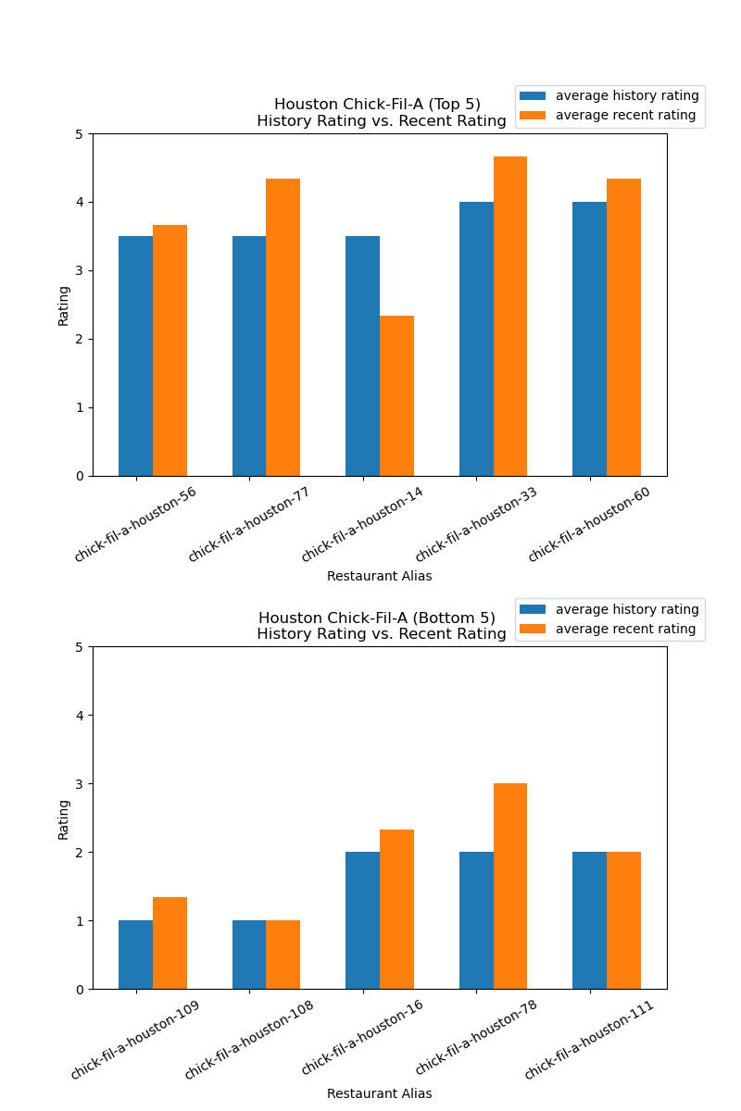
Customer Satisfaction
Houston, TX (Top 5)
4 out of 5 have experienced an increase in rating
1 out of 5 has seen a decrease in rating
Houston, TX (Bottom 5)
3 out of 5 have experienced an increase in rating

Slide 9
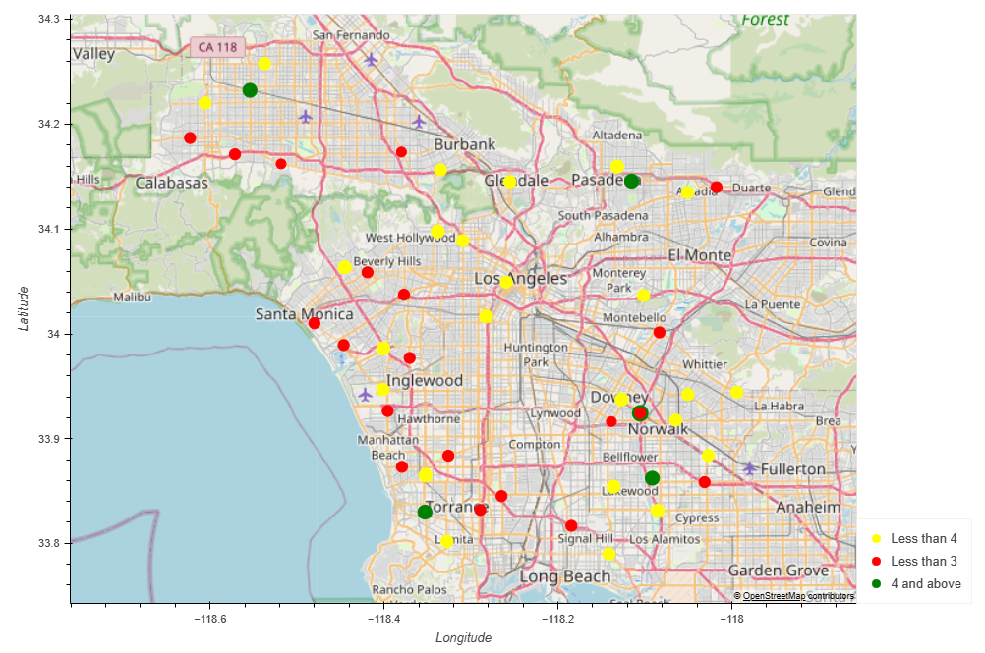

Ratings in Los Angeles

Slide 10
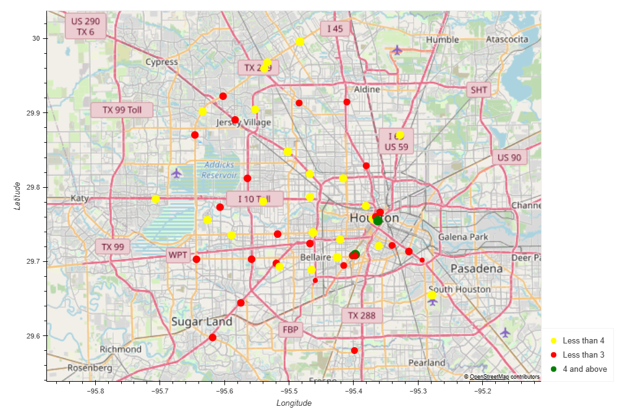
Ratings in Houston

Slide 11
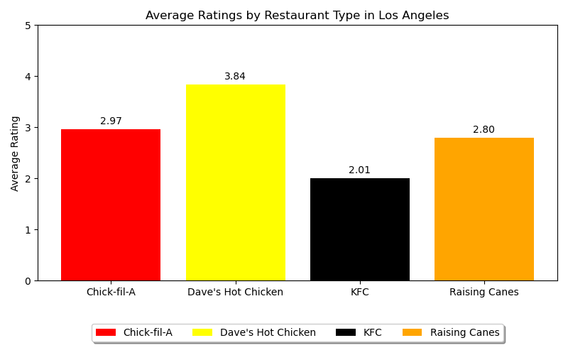
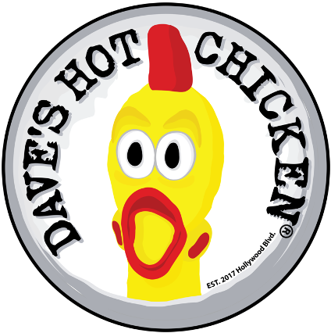
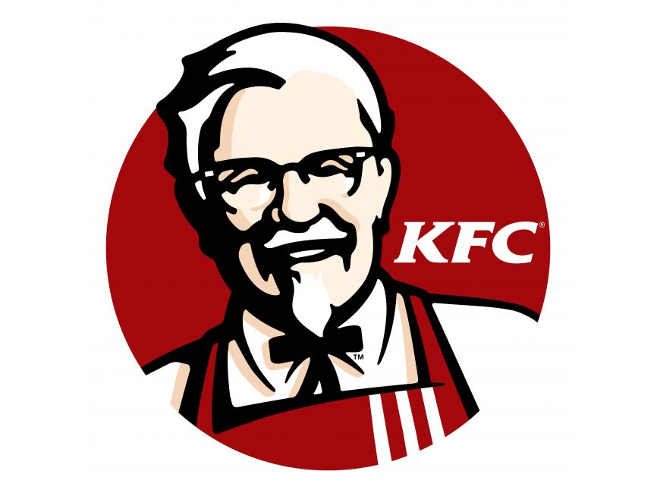

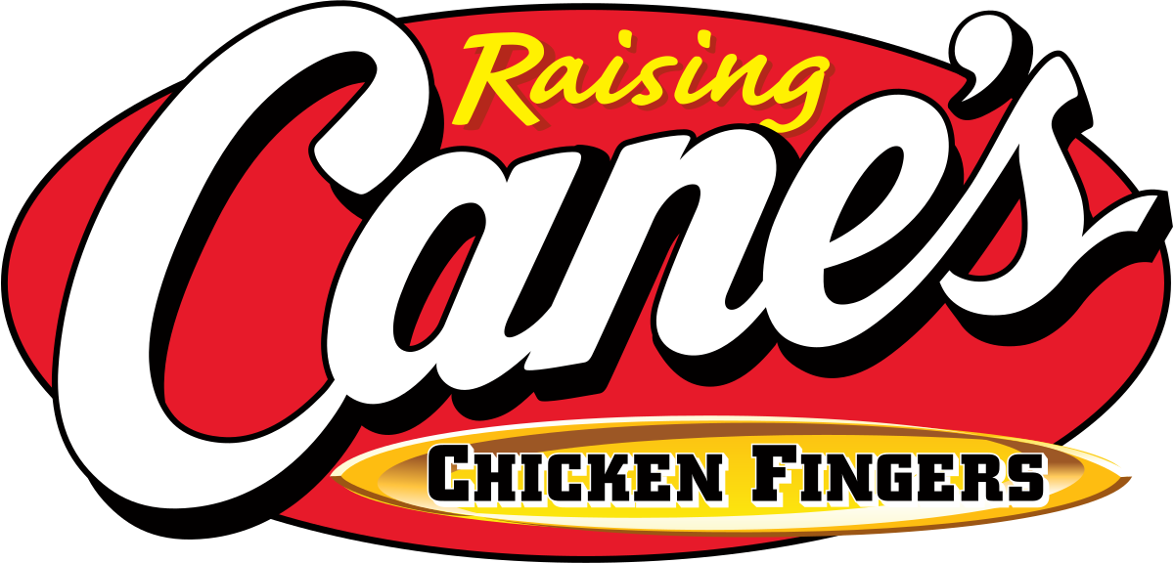
Competition
Dave’s Hot Chicken maintains the highest average rating (3.84) suggesting a strong and reliable customer satisfaction level.
Chick-fil-A and Raising Cane’s are both moderately rated for their customer service with average ratings of less than 3 stars.
KFC ranks the lowest, with an average customer rating of 2.01, in comparison to the other fast food restaurants.

Slide 12
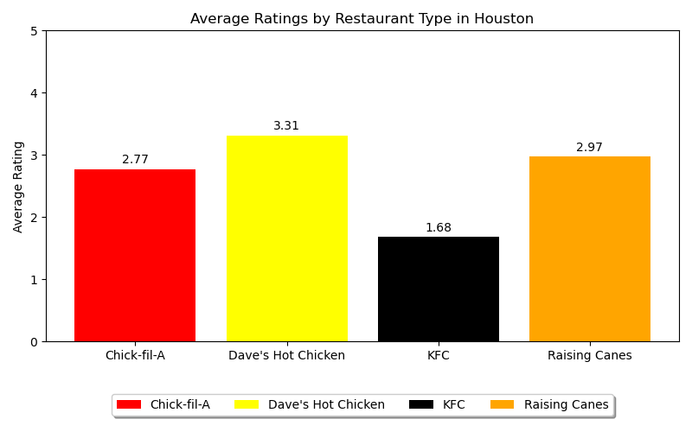
Competition
Dave’s Hot Chicken maintains the highest average rating (3.38) suggesting a strong and reliable customer satisfaction level.
Chick-fil-A and Raising Cane’s are both moderately rated for their customer service with average ratings of less than 3 stars.
KFC ranks the lowest, with an average customer rating of 1.68, in comparison to the other fast food restaurants.
Notes:
What does this mean for Chick-fil-A? Although Chick-fil-A, holds an average rating in the fast-food industry, it should prioritize improving customer service in order to compete more effectively with its competitors.

Slide 13
Summary
Geographical influence
Customer satisfaction
Competition
Los Angeles:
Chick-Fil-A's ratings vs. competitors reveal room for improvement.
Overall, restaurants showed positive rating trends, indicating a changing market.
Houston:
Similar to Los Angeles, Chick-Fil-A has scope for enhancement.
Rating improvements across restaurants suggest shifting customer sentiments.
Notes:
in our analysis, we took a deep dive into how Chick-Fil-A is performing in both Los Angeles and Houston. The CEO has a vision for a reputation incentive project by 2025, aiming to improve franchisee performance by considering location, ratings, and competitive positioning.
the breakdown: in Los Angeles, Chick-Fil-A is competing in a market where Dave’s Hot Chicken consistently scores high, indicating strong customer satisfaction. However, Chick-Fil-A's ratings, though decent, suggest room for improvement, especially when compared to competitors. Interestingly, even restaurants with lower ratings are showing recent improvements, reflecting a changing landscape.
Moving on to Houston, where we see a similar pattern. Dave’s Hot Chicken leads in customer satisfaction, while Chick-Fil-A and Raising Cane hold moderate ratings. Notably, KFC ranks lowest among fast-food chains. The exciting part? Ratings are on the upswing across multiple restaurants, signaling evolving customer sentiments.
What we've grasped from this analysis is the significance of grasping regional dynamics and customer preferences. Strengthening Chick-Fil-A's image and thriving in the reputation incentive project hinge on strategies focusing on elevating customer service and product quality. Learning from top competitors like Dave’s Hot Chicken and addressing weaknesses related to customer satisfaction can significantly propel Chick-Fil-A towards its long-term objectives.
Our findings strongly suggest the potential for Chick-Fil-A to enhance its business image. By leveraging these data-driven insights, Chick-Fil-A can refine its strategies, paving the way for a successful reputation incentive project, thereby fostering improved franchisee performance and sustained success.

